Slide 1



SMART MESSAGE
Never forget to notify…
…………………………………...........................................................
......
..
....
....
Guided By:
Prof. Hardik Jayswal
Prof. Dipak Ramoliya
Prepared By:
Krupali Dobariya (18DIT014)
Priyal Ramani (D19DIT082)

Slide 2
CONTENT
Introduction
Project Definition
Scope
Tools and Technology
Hardware and Software Requirements
Flowchart
Snapshot
Future Enhancement
References
Notes:
© Copyright Showeet.com – Free PowerPoint Templates

Slide 3
Introduction
Platform: Android
Purpose: Schedule notifications
Automatically send
Why this app?: No need of reminder
Filter from database
Notes:
© Copyright Showeet.com – Free PowerPoint Templates

Slide 4
Project Definition
01
02
03
04
Result Notification
Fees Payment Notification
Greetings Notification
Attendance Notification
Notes:
© Copyright Showeet.com – Free PowerPoint Templates

Slide 5
But How?
#1
Open application
#2
Select functionality
#3
Fetch from DB
#4
Send or schedule or delete or Re-schedule
Notes:
© Copyright Showeet.com – Free PowerPoint Templates

Slide 6
Result Notifications
#1
- Functionality
Firstly, result of the students will be added in the database.
Date will be set for sending the results by user.
Then for individual student result will be fetched from database and will be sent to individuals automatically by that scheduled time.
Notes:
© Copyright Showeet.com – Free PowerPoint Templates

Slide 7
Fees payment notifications
#2
- Functionality
In the database there will be entries of students who haven’t paid their fees.
On scheduled time students will be notified.
Notes:
© Copyright Showeet.com – Free PowerPoint Templates

Slide 8
Eligibility notifications
#3
- Functionality
Attendance report will be fetched from database.
Students will be informed if they are not eligible automatically.
Notes:
© Copyright Showeet.com – Free PowerPoint Templates

Slide 9
Scope
#1
Performance
#2
Reliability
#3
Scalability
Notes:
© Copyright Showeet.com – Free PowerPoint Templates

Slide 10
Tools and Technology
Front-End
Android Studio
Back-end
SQLite

Slide 11
Hardware and Software Requirements
For this application to run, it’s recommended to have…
Minimum 2 GB of RAM
Minimum 8 GB of Storage Area
Android OS Version 6.0 or above.
Notes:
© Copyright Showeet.com – Free PowerPoint Templates

Slide 12
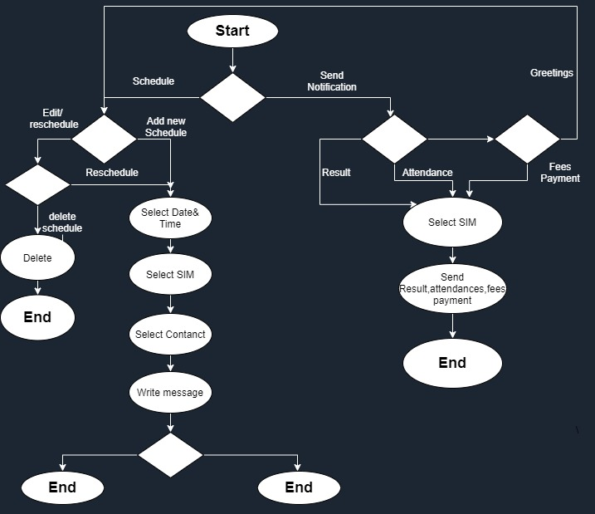
Flow Chart

Slide 13
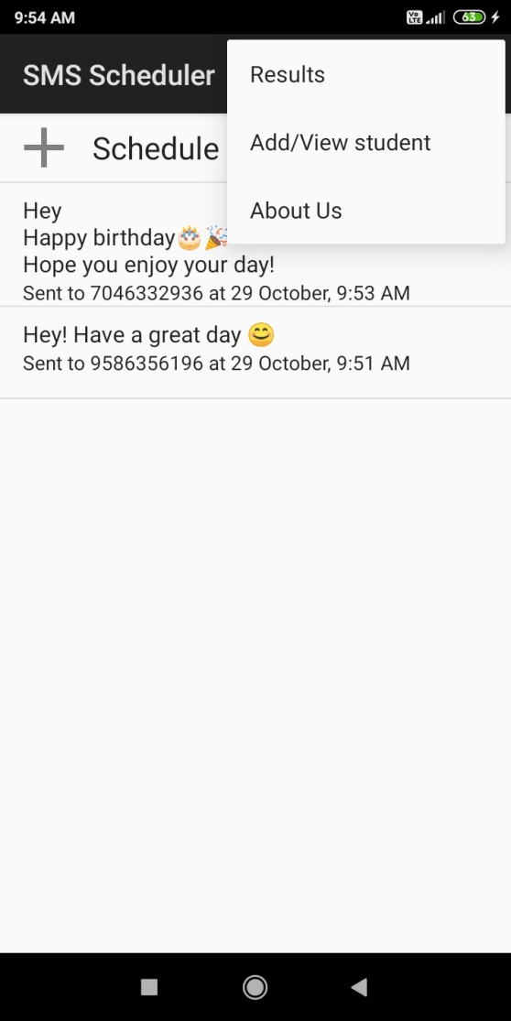
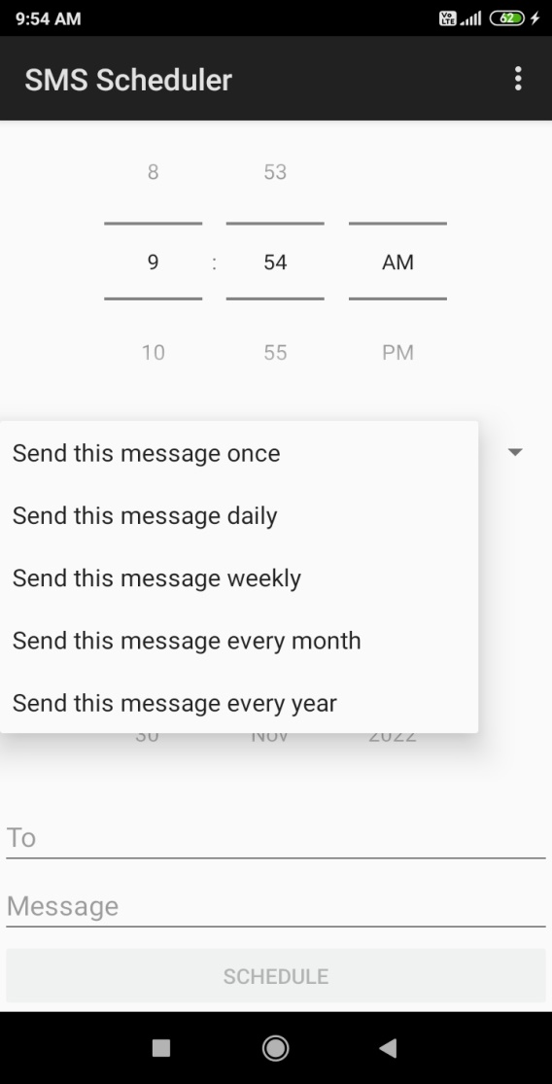
Screenshots
Display Schedule
Set Schedule

Slide 14
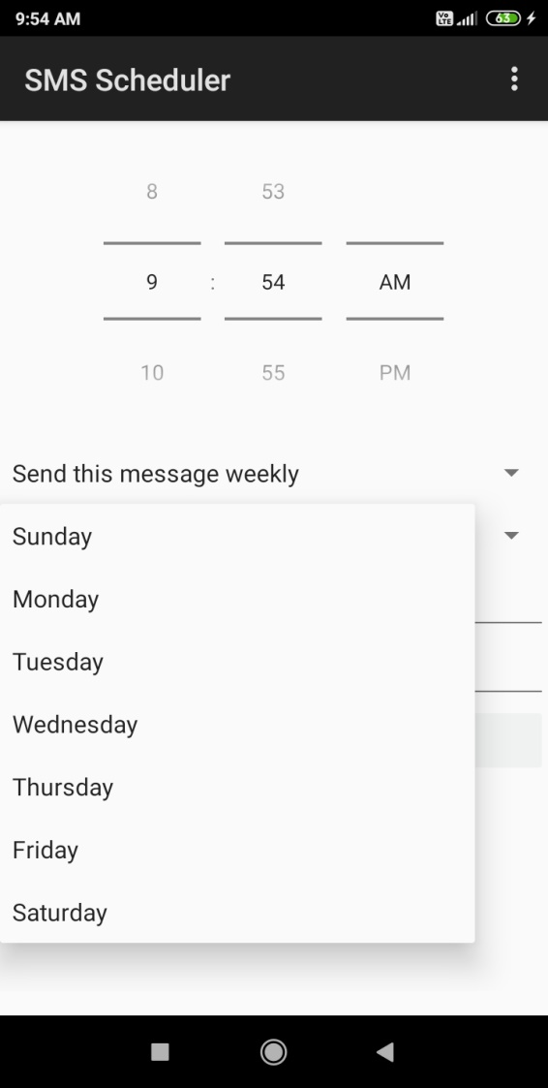
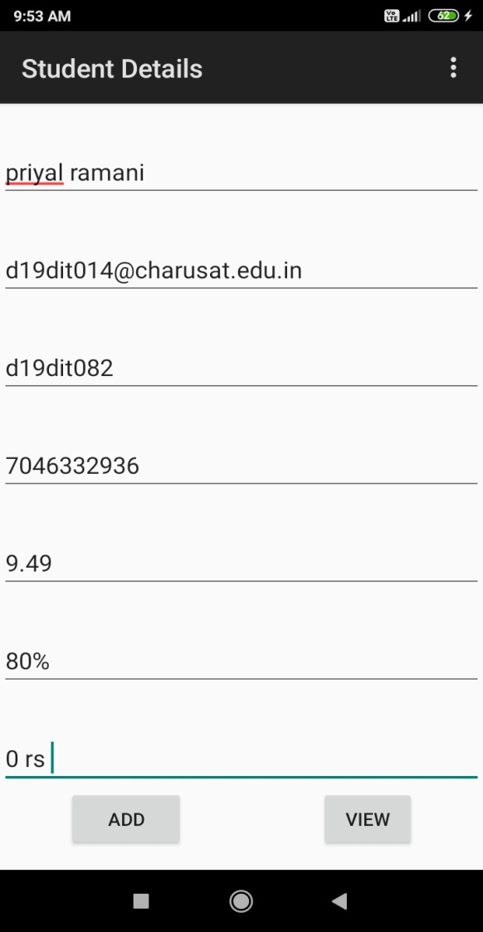
Cont.
Calendar view
Add Data

Slide 15
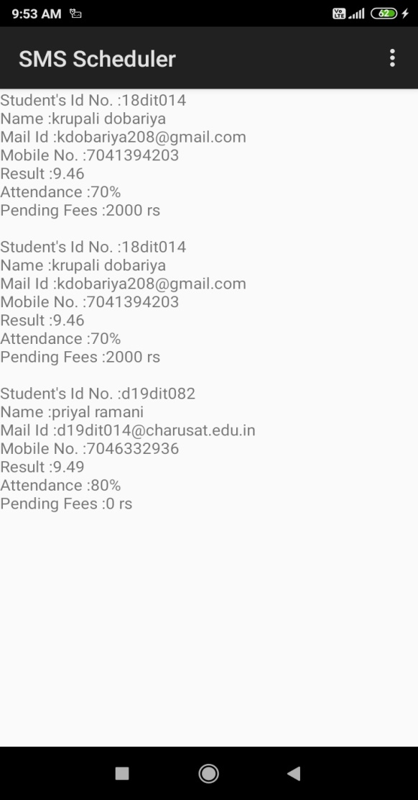
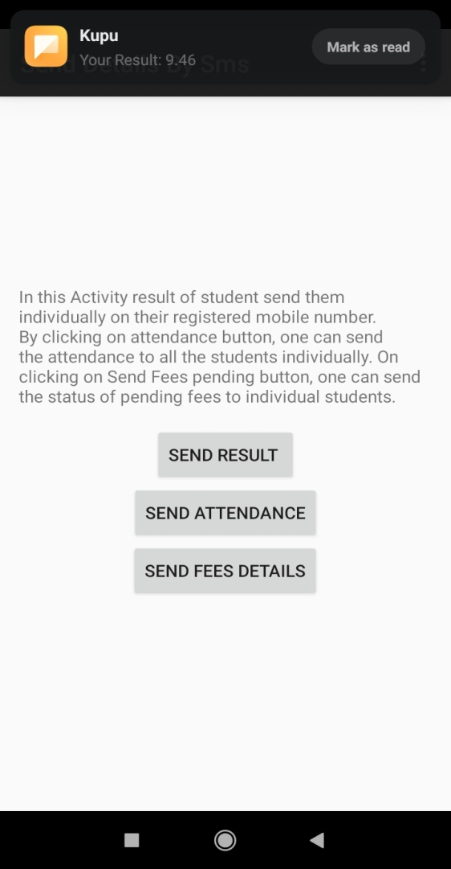
Cont.
View Data
Notification

Slide 16
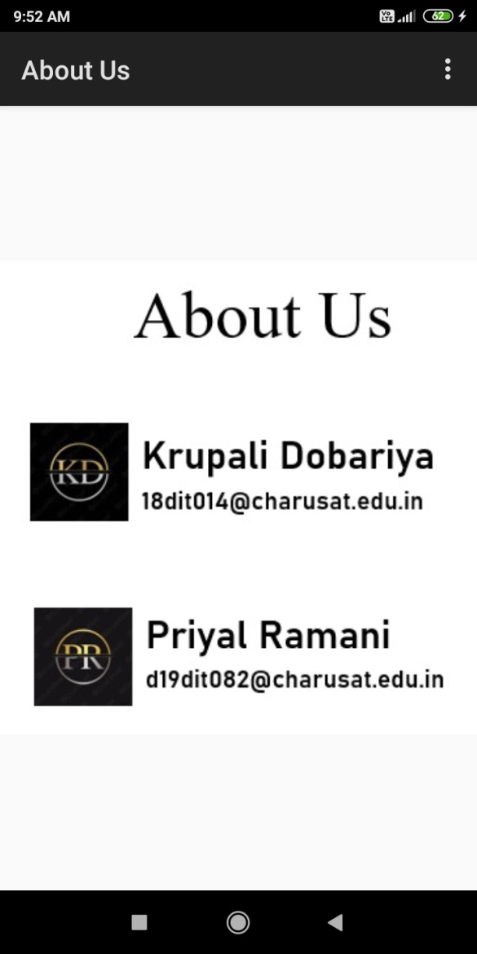
Cont.
About US

Slide 17
Future Enhancement
Specific Notification to Specific students
By their interest area
Add Security
By register and log in
Scheduling of group notification
Send notification By Mail

Slide 18
References
https://developer.android.com/guide/topics/ui/controls/spinner.html
https://developer.android.com/guide/topics/ui/notifiers/notifications.html
https://stackoverflow.com/
http://stackoverflow.com/questions/10032480/how-to-pass-data-to-broadcastreceiver

Slide 19
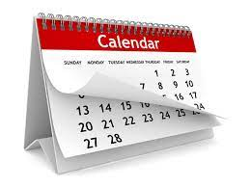
Thank You!
Krupali Dobariya
18dit014@charusat.edu.in
Priyal Ramani
d19dit082@charusat.edu.in
Notes:
© Copyright Showeet.com – Free PowerPoint Templates

